Slide 1

Launching AWS RDS from Visual Code
Ankita Phadke
03/23/23

Slide 2
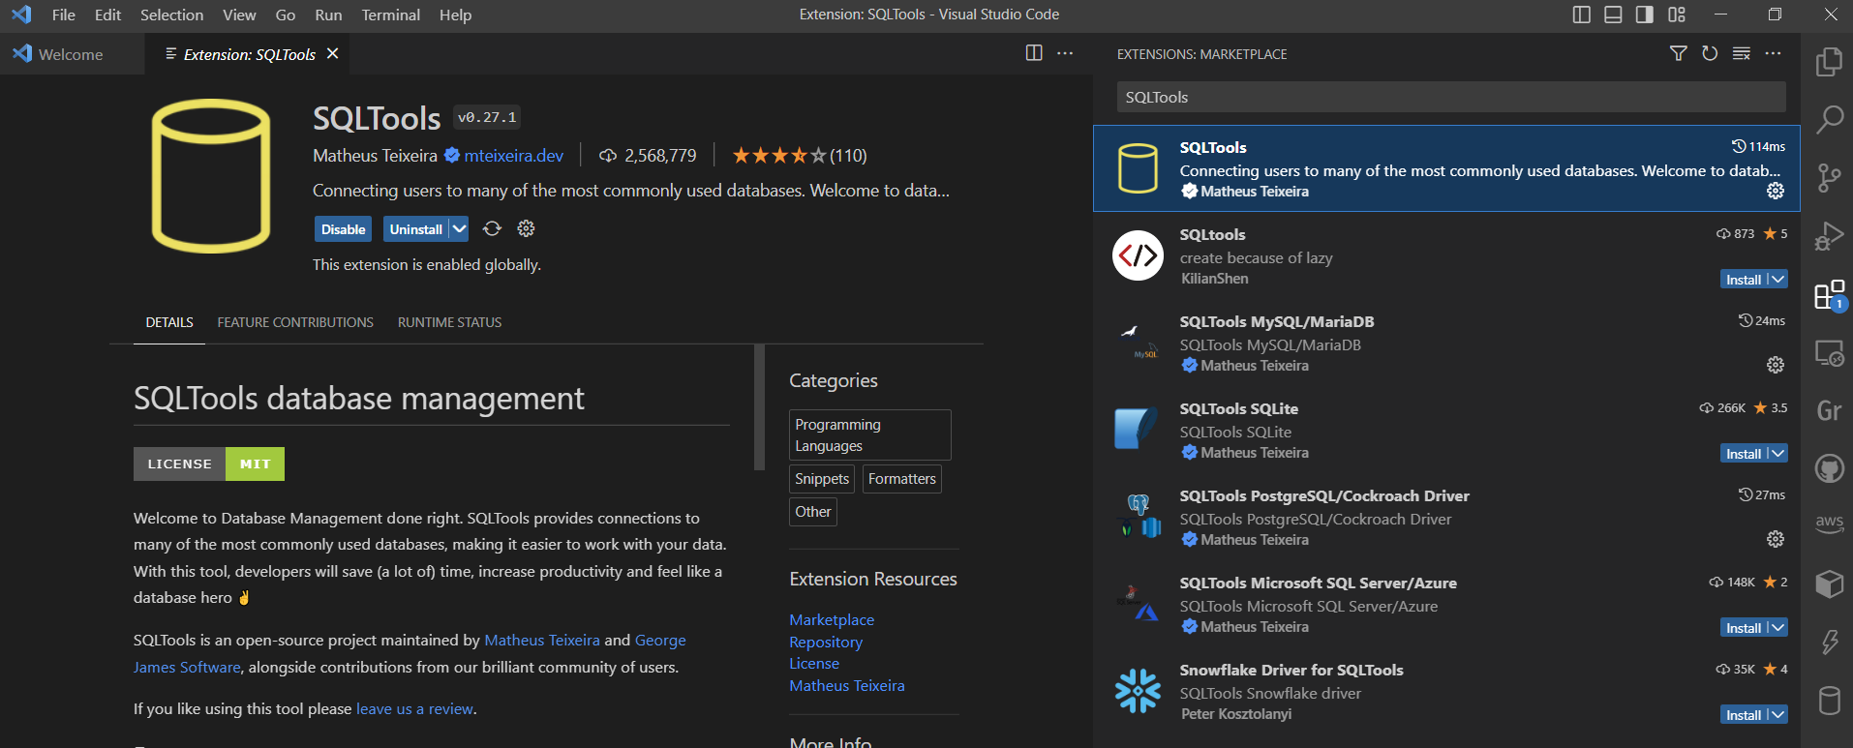
Connecting to existing AWS RDS from VSCode
Extension SQLTools is needed in VSCode, to use AWS RDS. Open Extensions > Marketplace > SQLTools
AWS Toolkit in VSCode doesn’t directly provide any options to connect to AWS RDS.

Slide 3
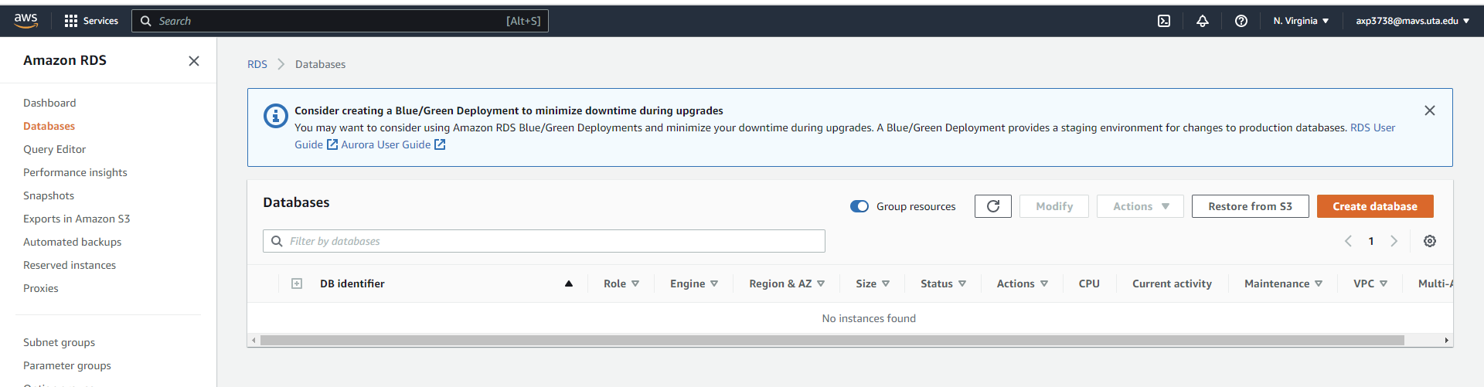
Connecting to existing AWS RDS from VSCode
2. Creating a test database in AWS RDS
Open AWS > Amazon RDS > Click on Create database

Slide 4
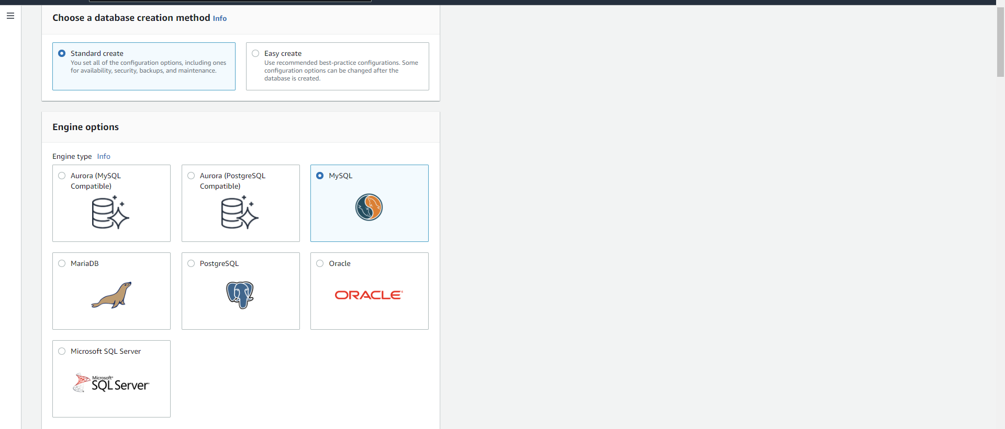
Connecting to existing AWS RDS from VSCode
3. Choose Standard create
Select MySQL database and appropriate/latest version – 8.0.28

Slide 5
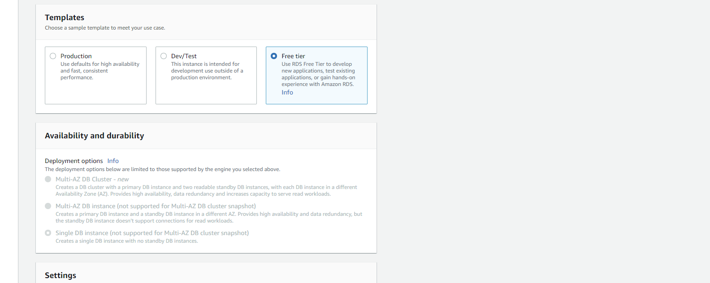
Connecting to existing AWS RDS from VSCode
4. Select Free Tier option
And select Single DB Instance

Slide 6
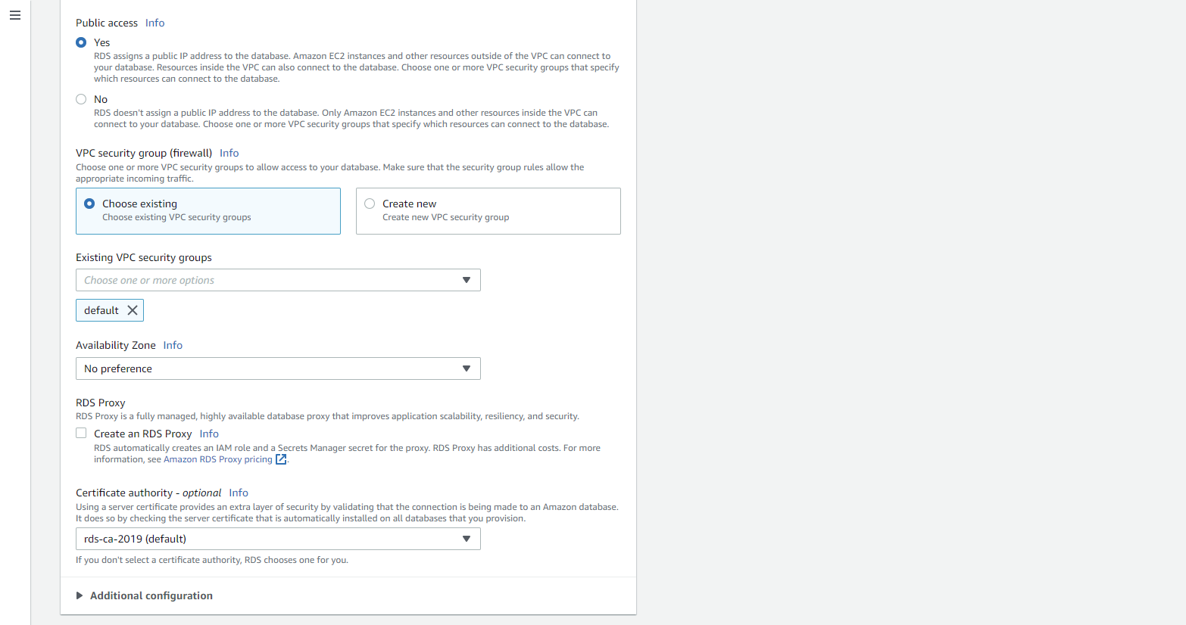
Connecting to existing AWS RDS from VSCode
5. Select ‘Yes’ to public access, so that database can be accessed from everywhere, select the Security group with access rights from every public machine.

Slide 7
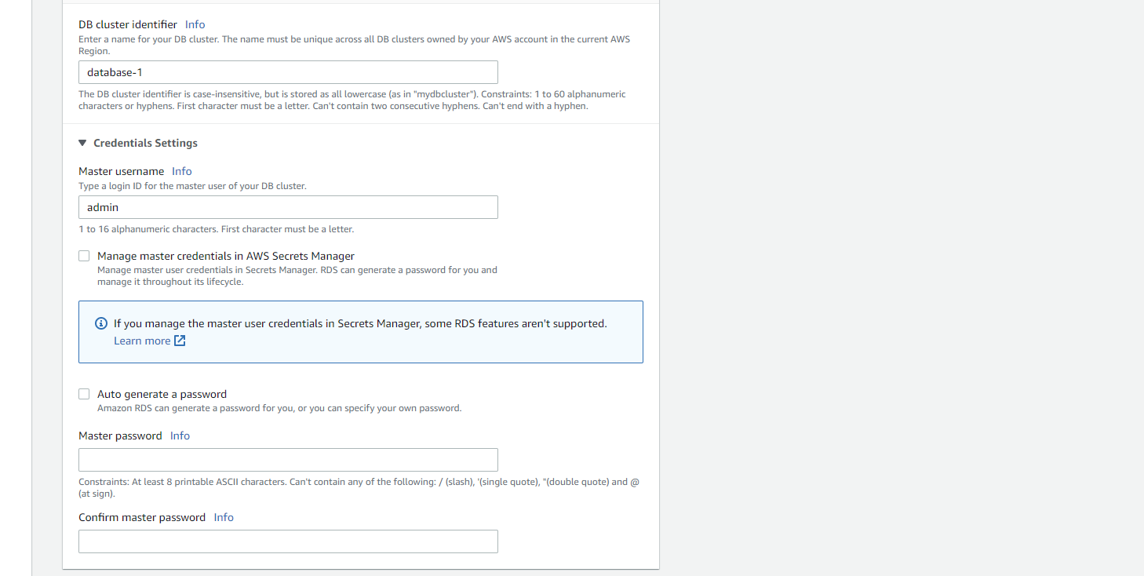
Connecting to existing AWS RDS from VSCode
6. Enter database name, username and password

Slide 8
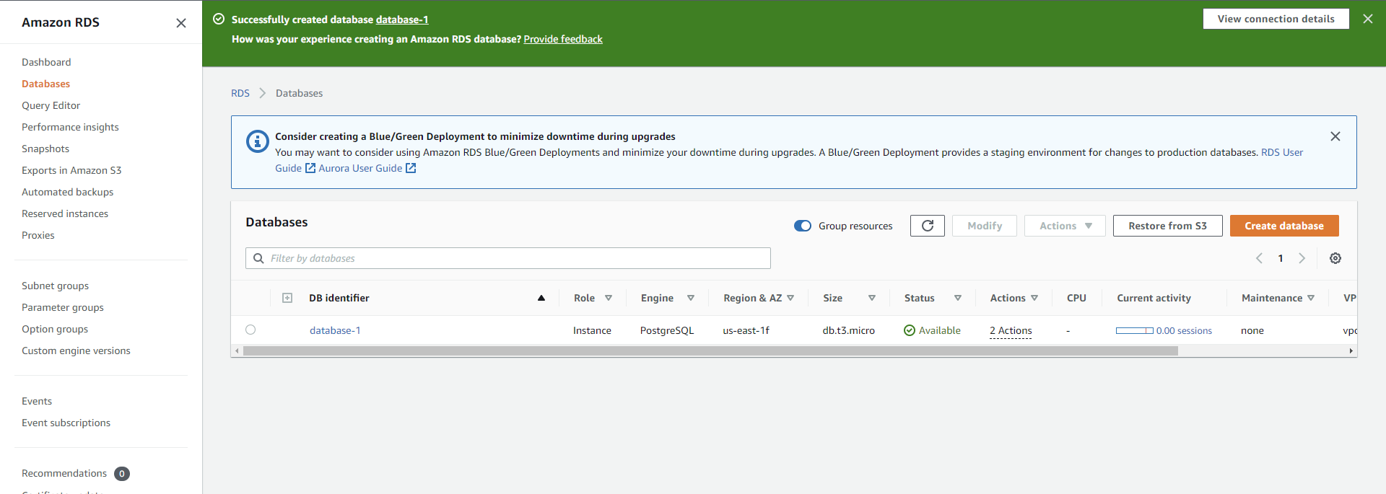
Connecting to existing AWS RDS from VSCode
7. Takes around 15-20 minutes to create the database.
Database details can be viewed from the database-1 link.

Slide 9
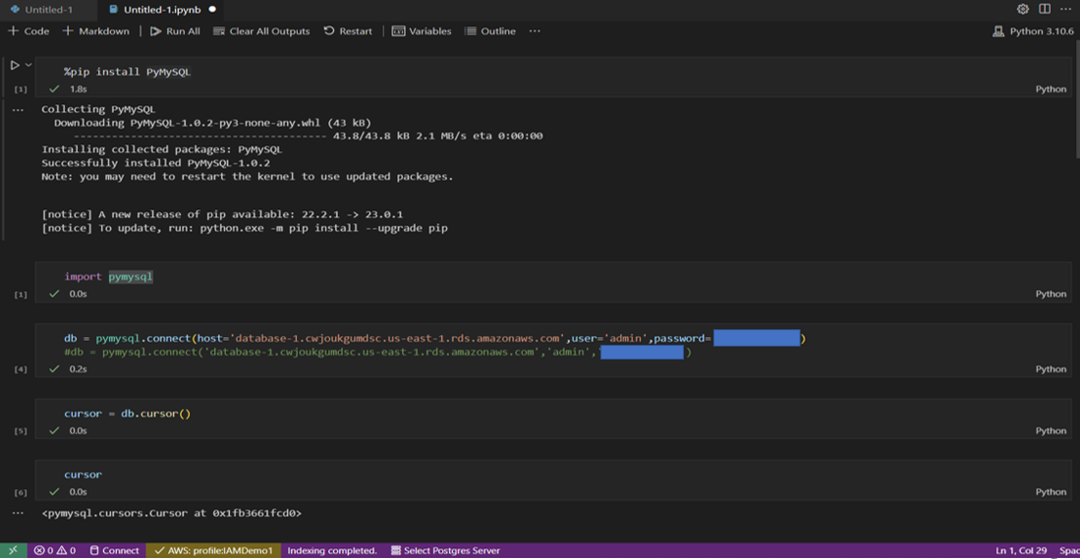
Connecting to AWS RDS from VSCode using Python

Slide 10
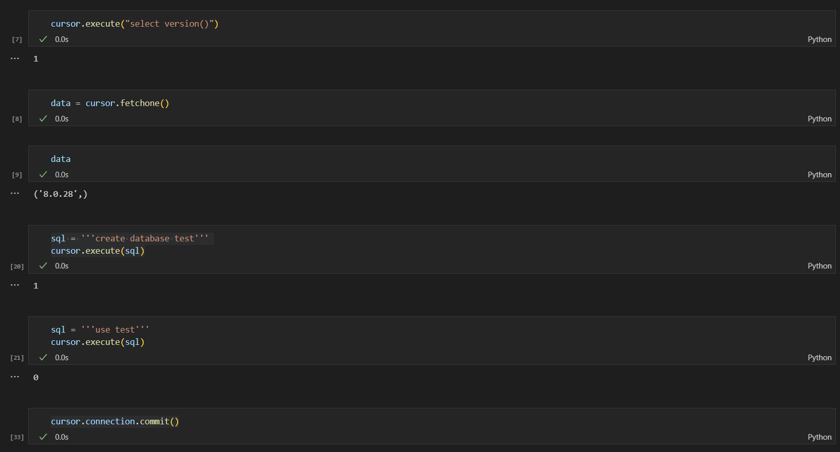
Connecting to AWS RDS from VSCode using Python

Slide 11
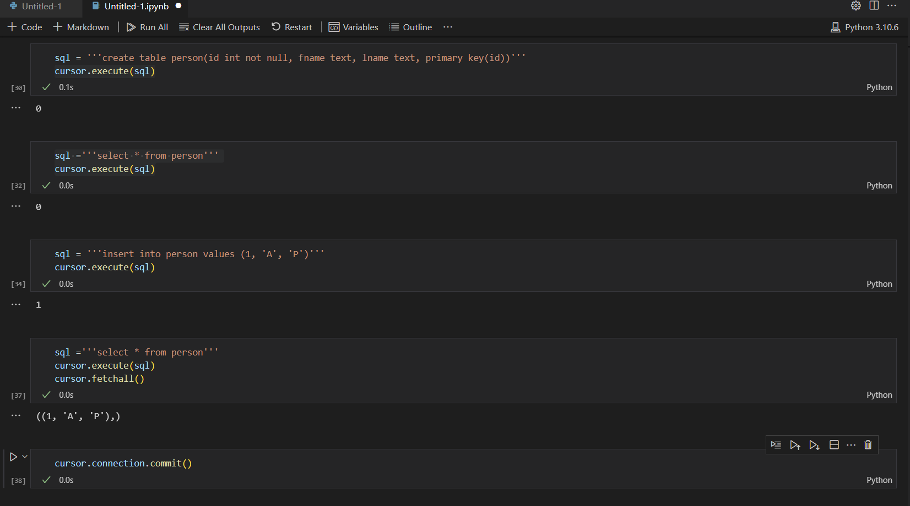
Connecting to AWS RDS from VSCode using Python

Slide 12
References:
https://medium.com/mpercept-academy/connecting-amazon-rds-for-postgresql-local-database-server-with-psql-pgadmin-visual-studio-code-719bea17489
https://youtu.be/RerDL93sBdY

